Slide 1

CAR EVALUATION
University of Siena
Levent Ergul

Slide 2
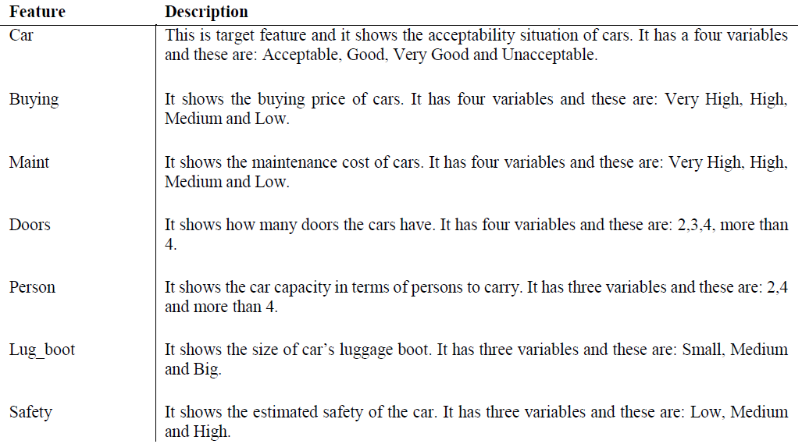
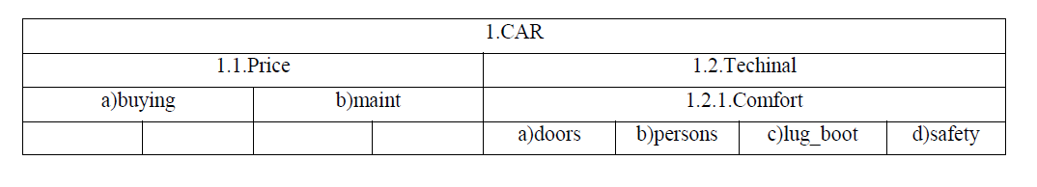
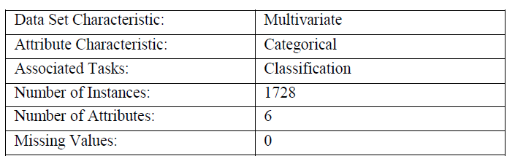
DATASET
Car Evaluation Database was derived from a simple hierarchical decision model originally developed for the demonstration of DEX, M. Bohanec, V. Rajkovic: Expert system for decision making.
Description of the features
Dataset specification

Slide 3
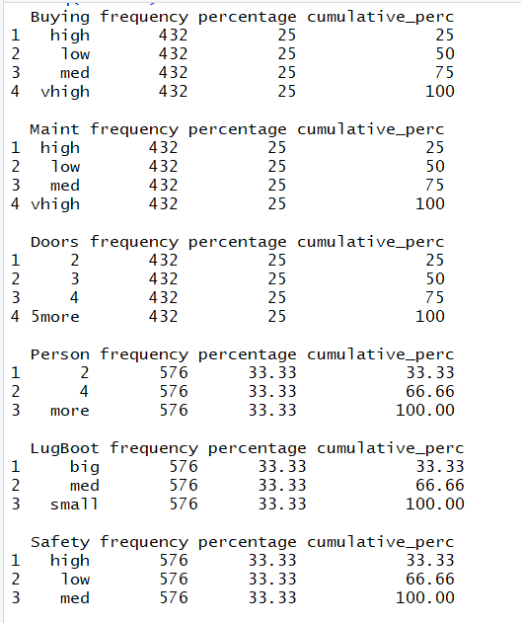
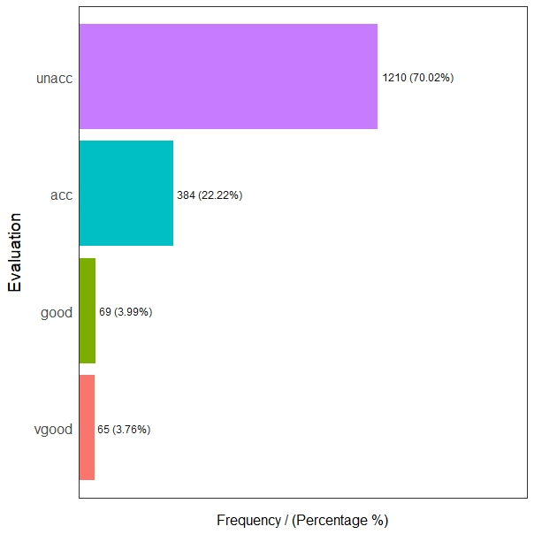
DATA VISUALISATION
Frequency of the target value:
Frequency of input features

Slide 4
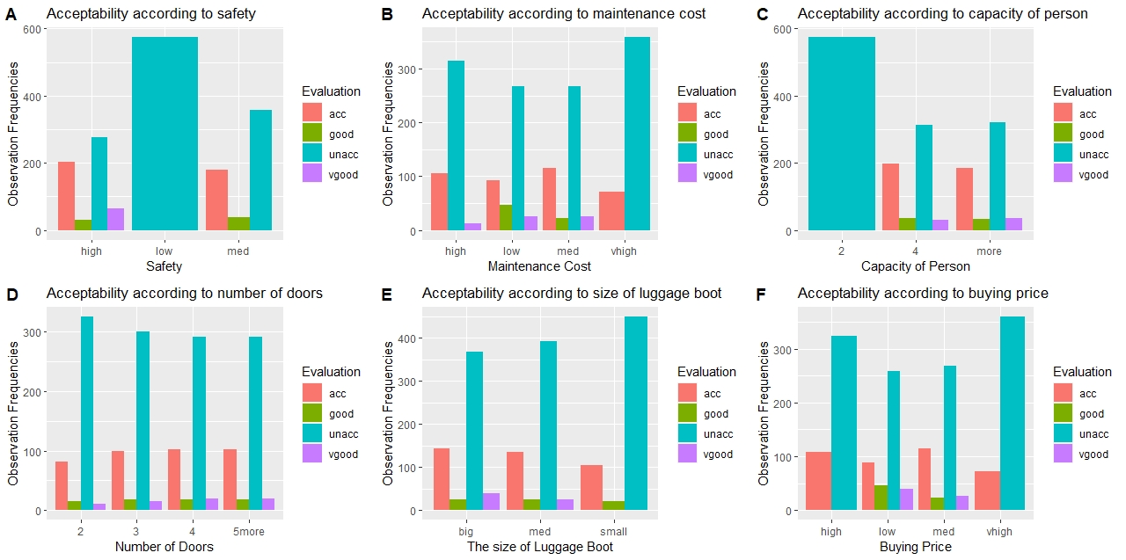
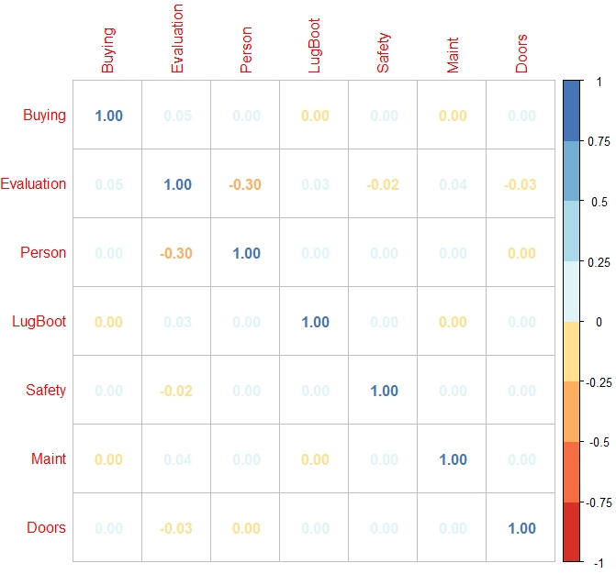
DATA EXPLORATION
Acceptability according to the input features
Correlation between the features

Slide 5

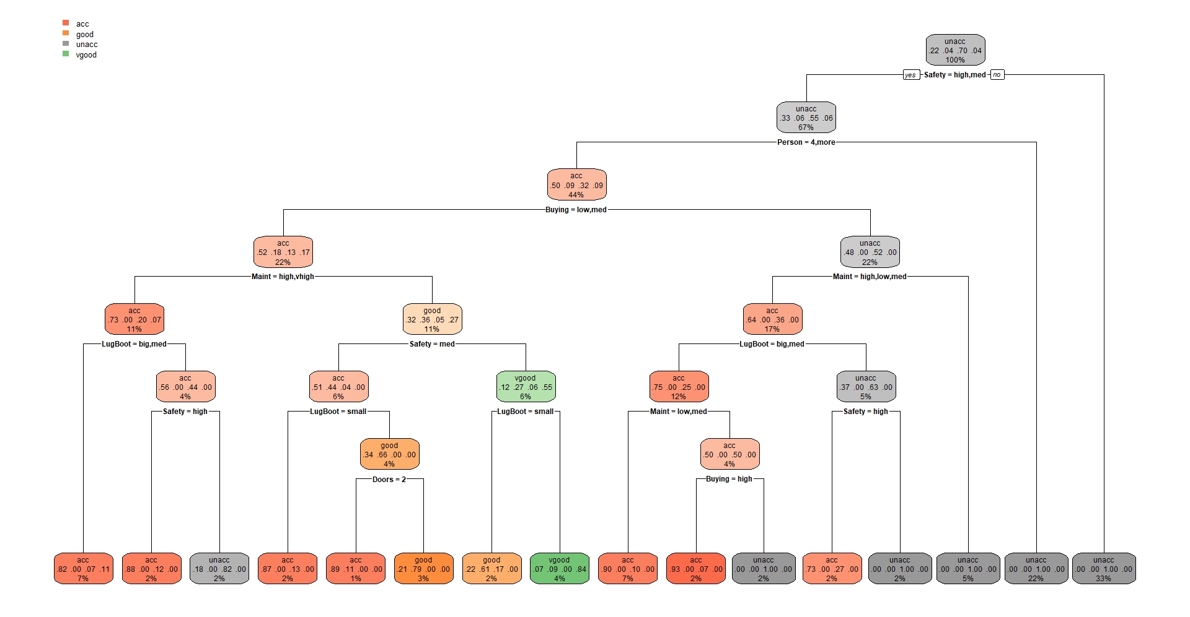
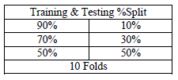
CLASSIFICATION
1) Algorithms
This part proceeds by two different methods. These are the Decision Tree and Naïve Bayes.
Decision Tree: excellent tools for helping us to choose between several courses of action. They provide a highly effective structure within which you can lay out options and investigate the possible outcomes of choosing those options. They also help you to form a balanced picture of the risks and rewards associated with each possible course of action.
Naïve Bayes: Probability approach, based on the computation of the a-posteriori conditional probability for the output variable, given the predictors (attributes).
Bayes Theorem for the computation of the probability that the output variable belongs to the target class.
Data split is 70% Training and 30% Testing
The train-test split procedure is used to estimate the performance of machine learning algorithms.
Dataset split for model creation

Slide 6
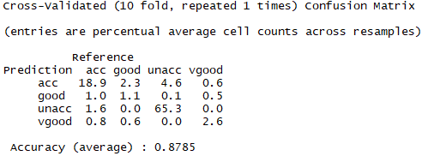
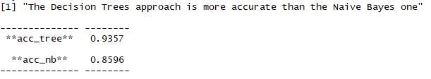
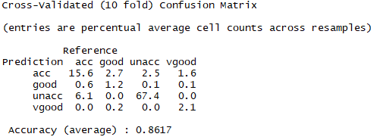
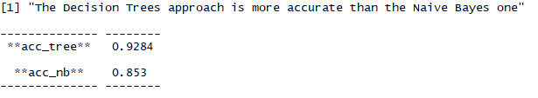
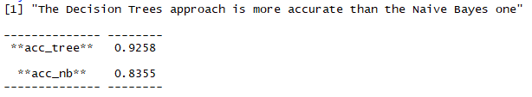
CLASSIFICATION
2) Results
4th Case: 10- Fold Cross Validation
Decision Tree:
1st Case: Data split is 90% Training and 10% Testing
Naïve Bayes:
2nd Case: Data split is 70% Training and 30% Testing
3rd Case: Data split is 50% Training and 50% Testing

Slide 7
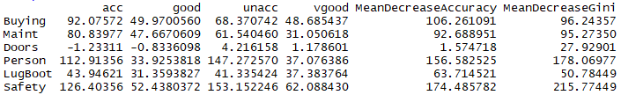
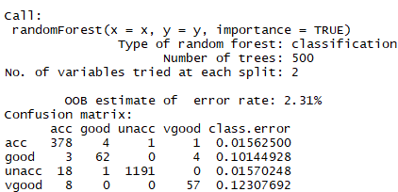
CLASSIFICATION
3)Feature Importance
Features importance
The feature importance (variable importance) describes which features are relevant. It can help with better understanding of the solved problem and sometimes lead to model improvements by employing the feature selection.
Random Forest: It construct many individual decision trees at training. Predictions from all trees are pooled to make the final prediction; the mode of the classes for classification or the mean prediction for regression. As they use a collection of results to make a final decision, they are referred to as Ensemble techniques.
The Random Forest algorithm has built-in feature importance which can be computed in two ways:
Gini importance (or mean decrease impurity), which is computed from the Random Forest structure.
Mean Decrease Accuracy - is a method of computing the feature importance on permuted out-of-bag (OOB) samples based on mean decrease in the accuracy.
Confusion Matrix

Slide 8


